Slide 1
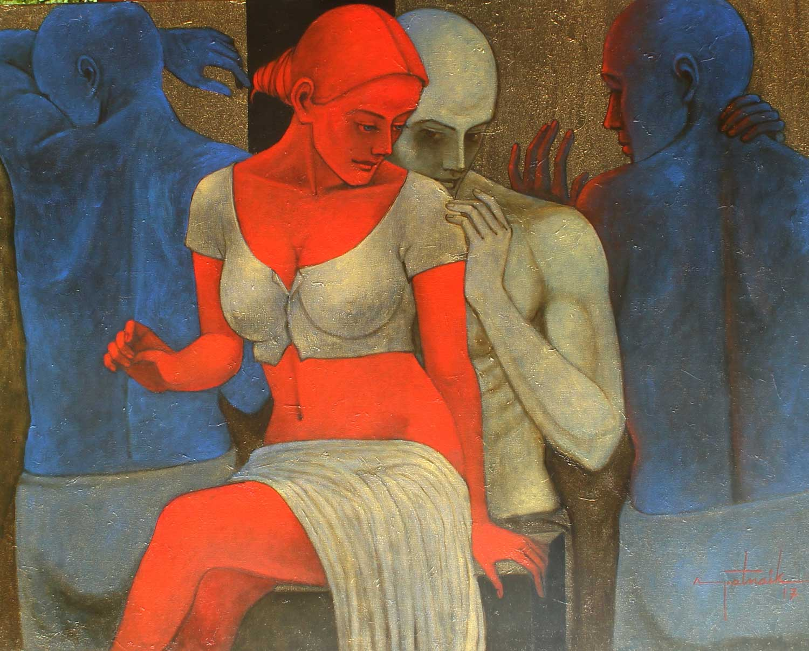
Asit Kumar Patnaik
Tandem Synchronicity
Acrylic on Canvas
42''X 53‘‘

Slide 2
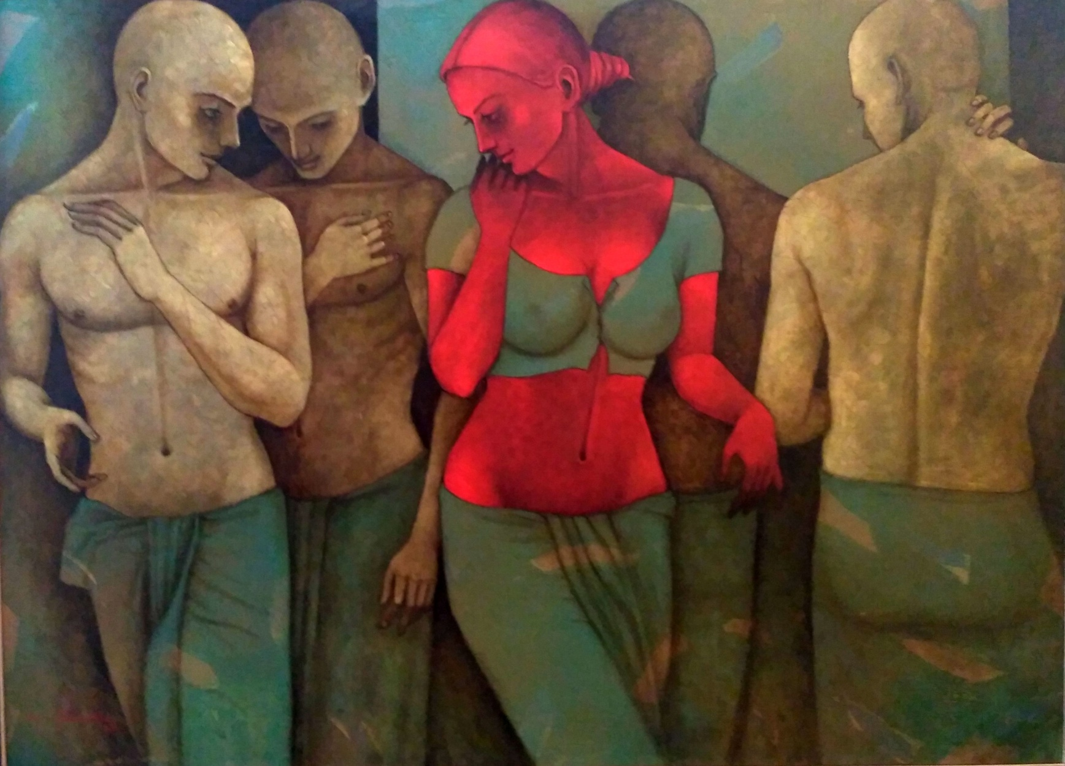
Asit Kumar Patnaik
Joyful Congregation
Acrylic & Oil on Canvas
60" x 82"

Slide 3
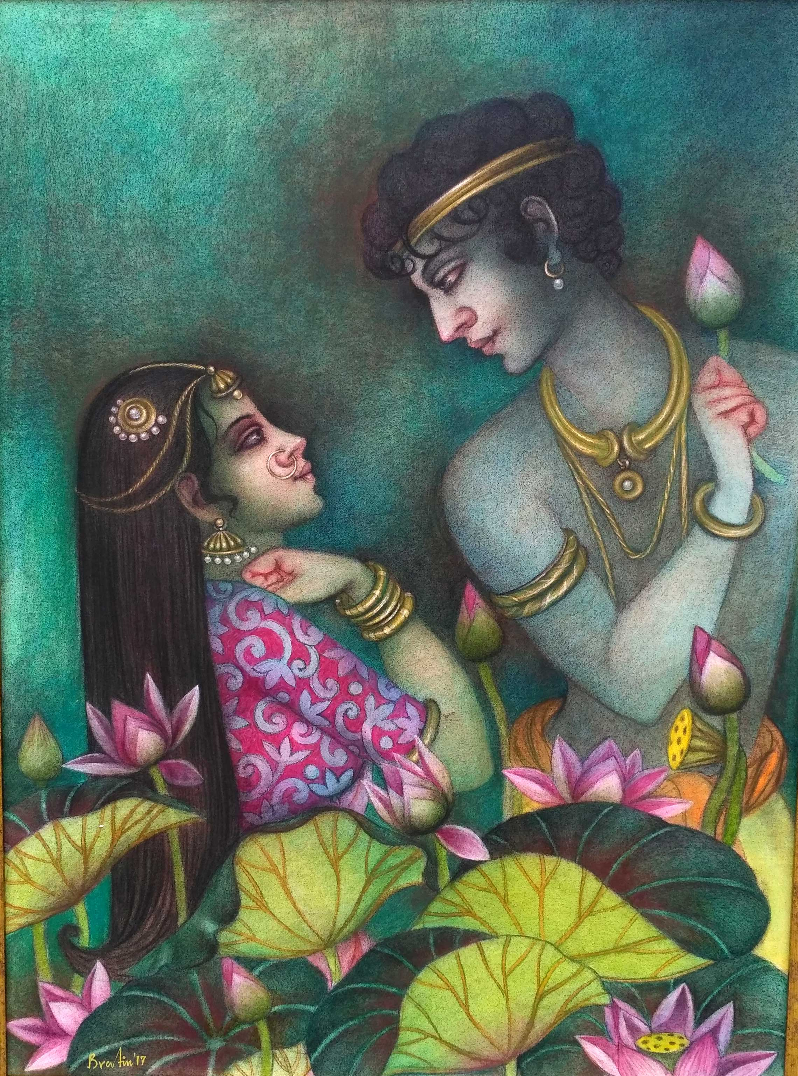
Bratin khan
Jugal
Tempera on Canvas
30”x 60”

Slide 4
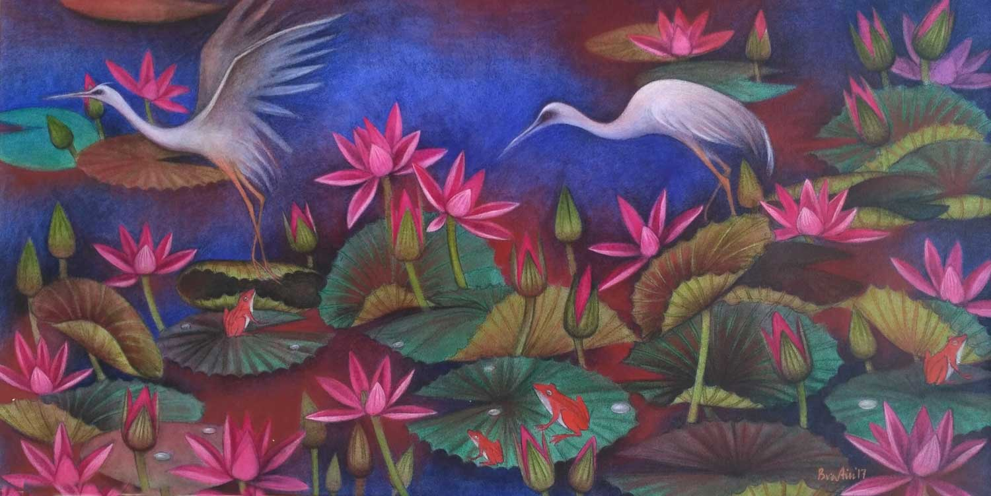
Bratin khan
Lily Pond
Tempera on Canvas
30”x 60”

Slide 5
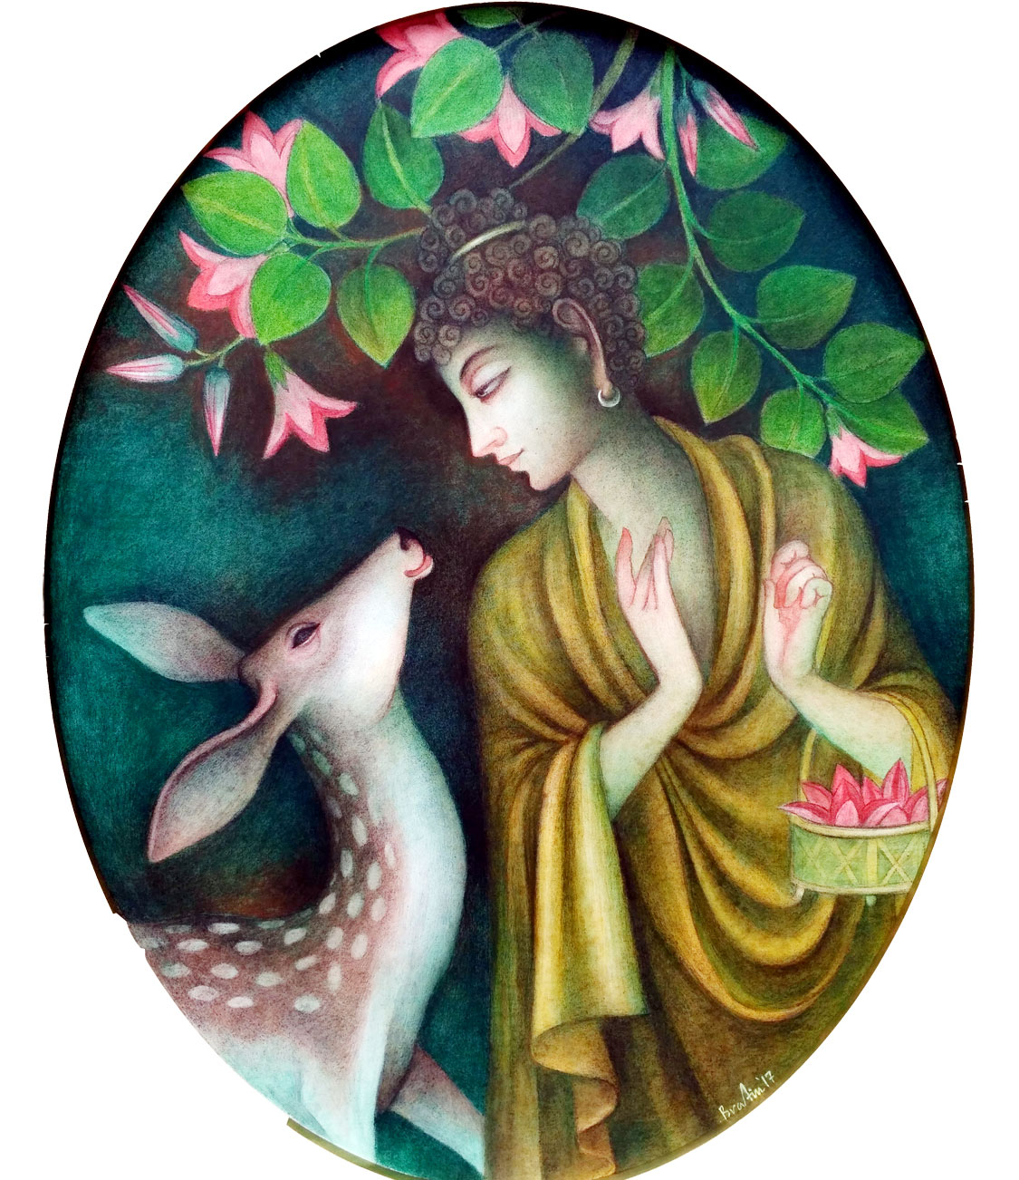
Bratin Khan
Enlightened Purusha
Tempera on Canvas
30”x 60”

Slide 6
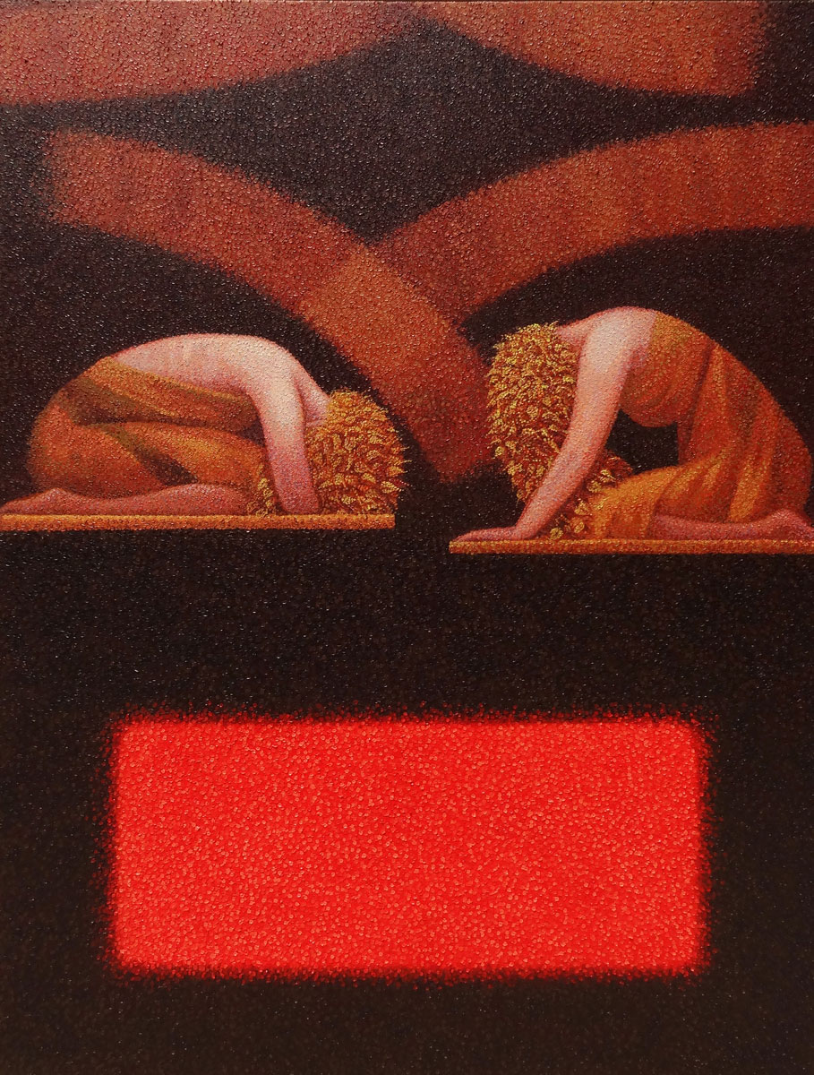
Kamar Alam
In The First Sunlight
Oil on Canvas
48”x 36”

Slide 7
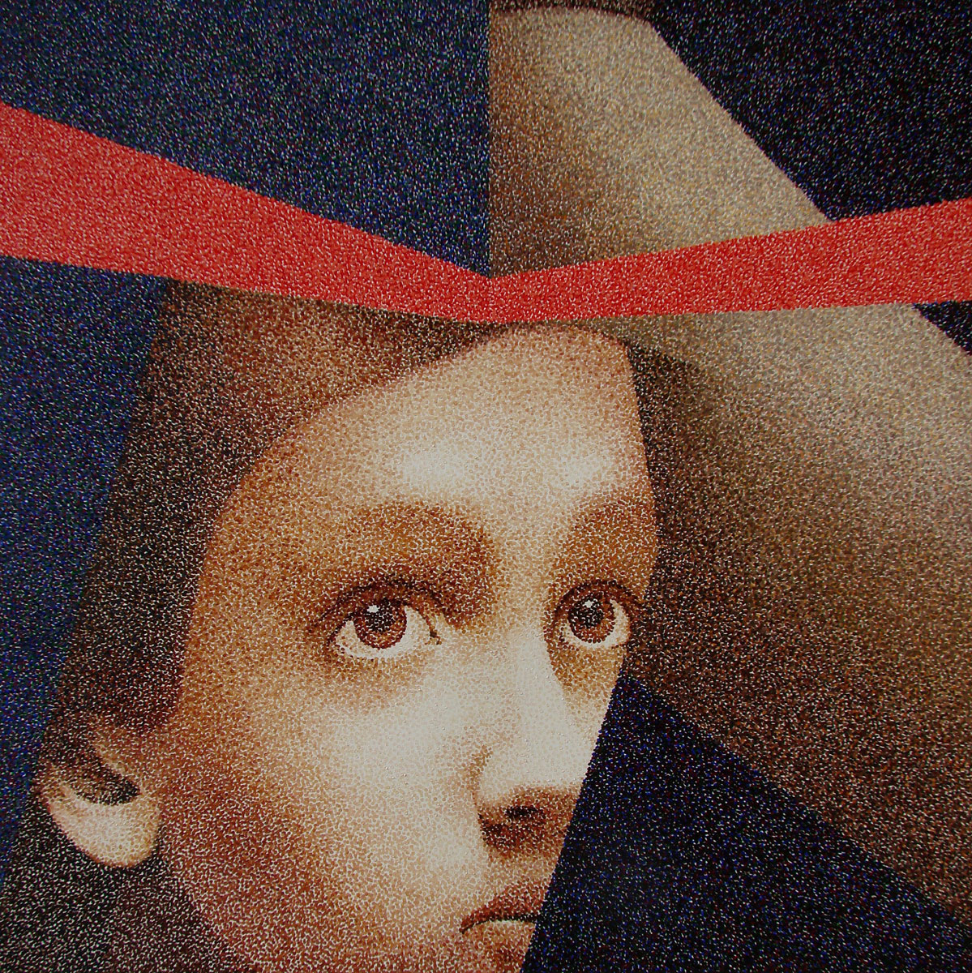
Kamar Alam,
Existence
Oil on Canvas
48” x 48”

Slide 8
Ramesh Gorjala Vishnu Mixed Media on Canvas 27”x 37’’

Slide 9
Ramesh Gorjala Kamadhenu Mixed Media on Canvas 27”x 37”

Slide 10
Ramesh Gorjala Krishna Mixed Media on Canvas 27”x 37”

Slide 11
Ramesh Gorjala Hanuman Mixed Media on Canvas 38”x 18”

Slide 12
Shampa Sircar Das Matsya Acrylic on Canvas 40” x 40”

Slide 13
Shampa Sircar Das Untitled (Lakshmi Series) Acrylic on canvas 40” x 40”

Slide 14
Shampa Sircar Das Cosmic Rhythm Acrylic on Canvas 26” x 46”

Slide 15
Shampa Sircar Das Untitled (Lakshmi Series) Acrylic on Canvas 26” x 46”

Slide 16
Shubhra Das
Transient Self
Oil on Canvas
28”x 35”

Slide 17
Shubhra Das
Royal Serenity
Oil on Canvas
29”x50’’

Slide 18
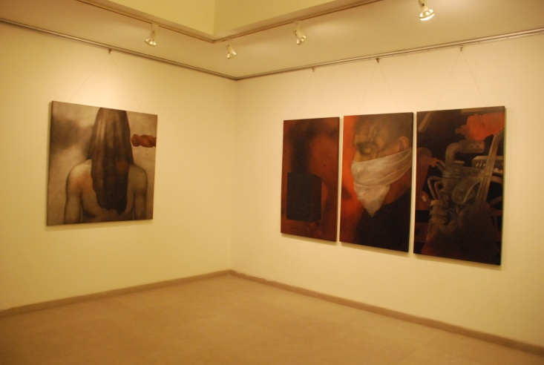
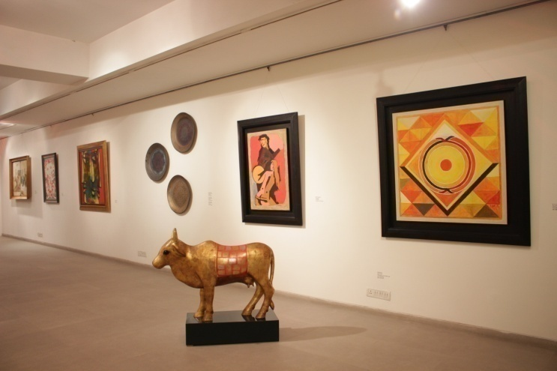
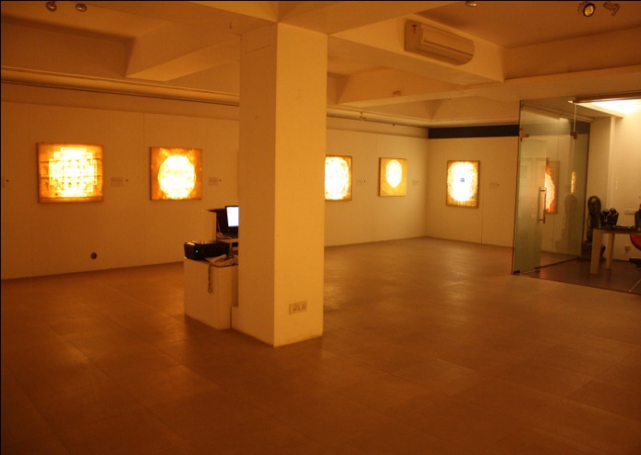
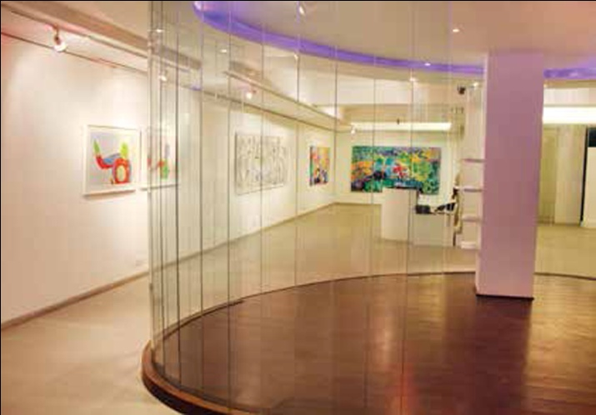
Gallery Art Positive F 213/ Lado Sarai New Delhi 110030 Ph: 011-46604128 www.galleryartpositive.com

